Slide 1
Asynchronous Data Transfer
Lecture 43-45

Slide 2
Data Transfer
Synchronous and Asynchronous Operations
Synchronous - All devices derive the timing information from common clock line
Asynchronous - No common clock
Asynchronous Data Transfer
Asynchronous data transfer between two independent units requires that
control signals be transmitted between the communicating units to
indicate the time at which data is being transmitted

Slide 3
Asynchronous Data Transfer
Asynchronous data transfer enables computers to send and receive data without having to wait for a real-time response. With this technique, data is conveyed in discrete units known as packets that may be handled separately.
Terminologies used in Asynchronous Data Transfer
Sender: The machine or gadget that transfers the data.
Receiver: A device or computer that receives data.
Packet: A discrete unit of transmitted and received data.
Buffer: A short-term location for storing incoming or departing data.
Classification of Asynchronous Data Transfer
Strobe Control Method
Handshaking Method

Slide 4
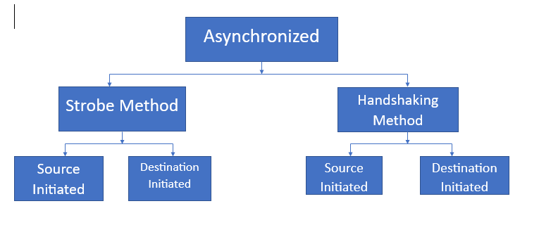

Slide 5
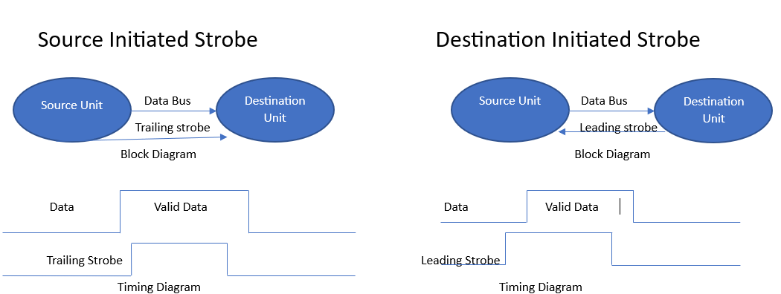

Slide 6
Asynchronous Data Transfer
Two Asynchronous Data Transfer Methods
Strobe pulse
- A strobe pulse is supplied by one unit to indicate the other unit when the transfer has to occur
Handshaking
- A control signal is accompanied with each data being transmitted to indicate the presence of data
- The receiving unit responds with another control signal to acknowledge receipt of the data

Slide 7
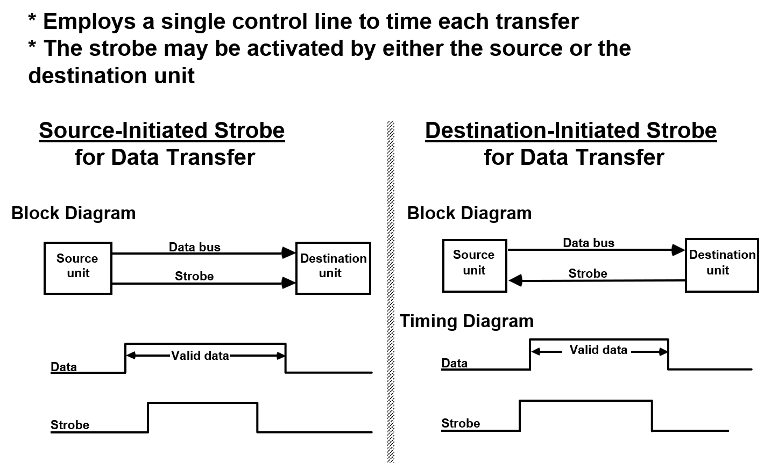
Strobe Control
* Employs a single control line to time each transfer
* The strobe may be activated by either the source or the destination unit

Slide 8
Strobe Control

Slide 9
Handshaking
Strobe Methods
Source-Initiated
The source unit that initiates the transfer has no way of knowing whether the destination unit has actually received data
Destination-Initiated
The destination unit that initiates the transfer no way of knowing whether the source has actually placed the data on the bus
To solve this problem, the HANDSHAKE method introduces a second control signal to provide a Reply to the unit that initiates the transfer

Slide 10
Source Initiated Transfer using Handshaking
Block Diagram
Source
Data valid
Destination
unit
Data accepted
unit
Timing Diagram
Data bus
Valid data
Data valid
Data accepted
Source unit
Sequence of Events
Destination unit
Place data on bus.
Enable data valid.
Accept data from bus.
Enable data accepted
Disable data valid.
Invalidate data on bus.
Disable data accepted.
Ready to accept data
(initial state).
* Allows arbitrary delays from one state to the next
* Permits each unit to respond at its own data transfer rate
* The rate of transfer is determined by the slower unit

Slide 11
Destination Initiated Transfer
using Handshaking
Block Diagram
Source
Data valid
Destination
unit
Ready for data
unit
Ready for data
Data valid
Data bus
Valid data
Sequence of Events
Source unit
Destination unit
Ready to accept data.
Place data on bus.
Enable ready for data.
Enable data valid.
Accept data from bus.
Disable data valid.
Disable ready for data.
Invalidate data on bus
(initial state).
* Handshaking provides a high degree of flexibility and reliability because the successful completion of a data transfer relies on active participation by both units
* If one unit is faulty, data transfer will not be completed -> Can be detected by means of a timeout mechanism

Slide 12
Serial Transfer
Four Different Types of Transfer
Asynchronous serial transfer
Synchronous serial transfer
Asynchronous parallel transfer
Synchronous parallel transfer
Asynchronous Serial Transfer
- Employs special bits which are inserted at both ends of the character code
- Each character consists of three parts; Start bit; Data bits; Stop bits.
1
1
0
0
0
1
0
1
Start
Character bits
Stop
bits
A character can be detected by the receiver from the knowledge of 4 rules;
- When data are not being sent, the line is kept in the 1-state (idle state)
- The initiation of a character transmission is detected by a Start Bit , which is always a 0
- The character bits always follow the Start Bit
- After the last character , a Stop Bit is detected when the line returns to the 1-state for at least 1 bit time
The receiver knows in advance the transfer rate of the bits and the number of information bits to expect

Slide 13
Universal Asynchronous
Receiver Transmitter
A typical asynchronous communication interface available as an IC
Transmit
Bidirectional
Transmitter
Shift
data
data bus
Bus
register
register
buffers
Control
Transmitter
Transmitter
register
control
clock
Chip select
and clock
CS
Internal Bus
RS
Timing
Status
Receiver
Receiver
CS RS Oper. Register selected
register
control
clock
0 x x None
I/O read
RD
and
and clock
1 0 WR Transmitter register
Control
Receive
1 1 WR Control register
I/O write
WR
Receiver
Shift
data
1 0 RD Receiver register
register
register
1 1 RD Status register

Slide 14
Universal Asynchronous
Receiver Transmitter
Transmitter Register
- Accepts a data byte(from CPU) through the data bus
- Transferred to a shift register for serial transmission
Receiver
- Receives serial information into another shift register
- Complete data byte is sent to the receiver register
Status Register Bits
- Used for I/O flags and for recording errors
Control Register Bits
- Define baud rate, no. of bits in each character, whether to generate and check parity, and no. of stop bits

Slide 15
First In First Out Buffer
* Input data and output data at two different rates
* Output data are always in the same order in which the data entered the buffer.
* Useful in some applications when data is transferred asynchronously
4 x 4 FIFO Buffer (4 4-bit registers Ri),
4 Control Registers(flip-flops Fi, associated with each Ri)
The figure is shown for reference in next slide

Slide 16
R1
R2
R3
R4
Data
4-bit
4-bit
4-bit
4-bit
Data
input
register
register
register
register
output
Clock
Clock
Clock
Clock
Insert
S
F
S
F
F
S
S
F
F
S
1
2
3
S
F
4
Output
F'
F'
F'
ready
F
F'
R
R
R
F'
R
R
1
2
3
R
4
Input ready
Delete
Master clear

Slide 17
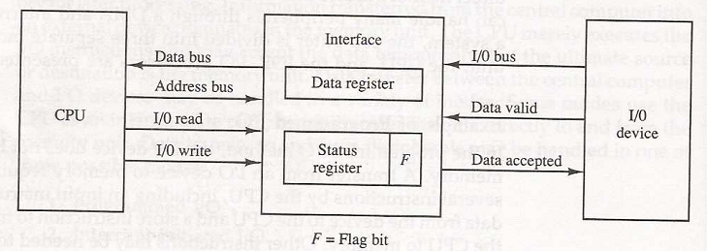
Modes of Transfer – Programmed I/O
3 different Data Transfer Modes between the central
computer(CPU or Memory) and peripherals;
Program-Controlled I/O
Interrupt-Initiated I/O
Direct Memory Access (DMA)
Program-Controlled I/O:
- Result of I/O Instructions written in Computer Program.
Each data item transfer is initiated by an instruction in the program.
CPU stays in program loop until the I/O indicates that it is ready for the data transfer, so it is
time consuming.
Data transfer from I/O device to CPU

Slide 18
Inter Processor Arbitration
System Bus - A Backplane level bus
- Printed Circuit Board
- Connects CPU, IOP, and Memory
- Each of CPU, IOP, and Memory board can be plugged into a slot in the system bus
- Bus signals are grouped into 3 groups
Data, Address, and Control(plus power)
- Only one of CPU, IOP, and Memory can be granted to use the bus at a time
- Arbitration mechanism is needed to handle multiple requests
e.g. IEEE standard 796 bus
- 86 lines
Data: 16(multiple of 8)
Address: 24
Control: 26
Power: 20

Slide 19
Synchronous and Asynchronous
Data Transfer
Synchronous Bus
Each data item is transferred over a time slice known to both source and destination unit
- Common clock source Or, separate clock and synchronization signal is transmitted periodically to synchronize the clocks in the system
Asynchronous Bus
Each data item is transferred by Handshake mechanism
- Unit that transmits the data transmits a control signal that indicates the presence of data
- Unit that receiving the data responds with another control signal to acknowledge the receipt of the data
Strobe pulse - supplied by one of the units to indicate to the other unit when the data transfer has to occur

Slide 20
Handshaking Method For Data Transfer
During an asynchronous data transfer, two devices manage their communication using handshaking. It is guaranteed that the transmitting and receiving devices are prepared to send and receive data. Handshakes are essential in asynchronous communication since there is no clock signal to synchronize the data transfer.
During handshaking, we use two types of signals mostly they are request-to-send (RTS) and clear-to-send (CTS). The receiving device is notified by an RTS signal when the transmitting equipment is ready to provide data. The receiving device responds with a CTS signal when it is ready to accept data.
once data is transmitted to the receiver end. the receiver generates a signal that it has done by sending an acknowledgment (ACK) signal. If the data is not successfully received, the receiving device will notify that a new transmission is necessary via a negative acknowledgment (NAK) signal.

Slide 21
The handshaking procedure guarantees synchronized and dependable data delivery. Additionally, it allows for flow management, preventing the transmitting device from sending the receiving device an excessive amount of data all at once. In order to offer flow control, handshaking signals are utilized to regulate the rate at which data is sent.
The Handshaking Method in asynchronous data transfer is used in different devices for the transfer of data to ensure reliable communication.

Slide 22
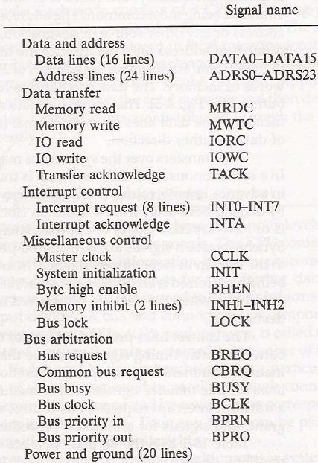
IEEE Standard 796 Multibus Signals
- address
- data
- control
- arbitration
- interrupt
- timing
- power, ground
Bus signal allocation

